Slide 1
Introduction to Classification

Slide 2

By the end of the lesson, you should be able to:
1. | Explain classification.
2. | Explain the benefits of using a classification for living organisms.

Slide 3

What is classification?
Think about going to a shop. Have you ever noticed that all the products are grouped together into different types?
Imagine trying to find something in a shop where all the items were not organised!

Slide 4
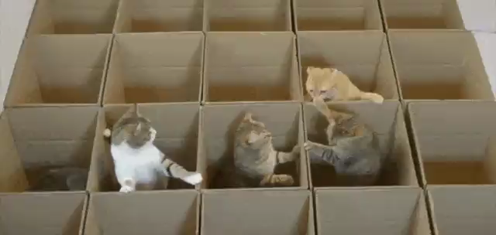
Classification is the organisation of items into particular groups.
It's like putting different things in particular boxes so it makes them easier to look for and understand!

Slide 5
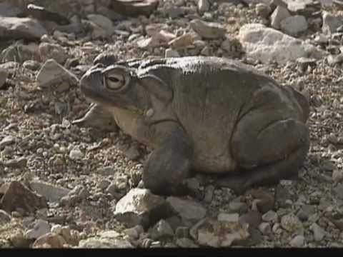

Slide 6

Classification is based on certain characteristics.
It depends on how you want to organise the things you have. It could be based on their size, shape, colour, roundness, smoothness or the material they are made of.
Any characteristic that links or separates multiple objects can be used for classification.

Slide 7
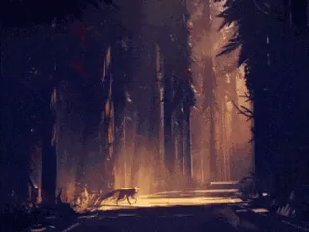
Why do we classify things?
Scientists discover lots of new things all the time. In science, communication is key!
When something new is discovered, it must be classified so that everybody knows what the thing is.

Slide 8
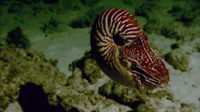
Classification is useful for lots of reasons!
Scientists all over the world use the same rules for classifying organisms (living things).
All organisms have a scientific name which is the same in every language. This makes it a lot easier for scientists from different countries to communicate without getting mixed up.

Slide 9
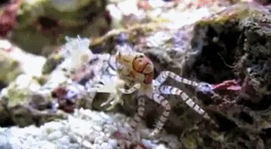
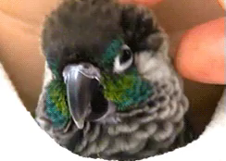
Biologists study living things and classify them based on observable characteristics.
For example, insects and crabs are classified as invertebrates because they have no backbone.
Fish, birds and mammals are classified as vertebrates because they have a backbone.

Slide 10
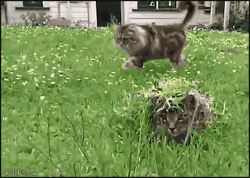
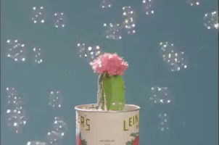
For this topic we will focus on the classification of living things - organisms.
It's the science of knowing your cat is different from your cactus, but how does it really work?

Slide 11


